Slide 1
H₂OW LOW
...can you go?
Veronica | Nico | Matthew | Jane

Slide 2
Overview
Tasks and key changes
Revised UI design
Scenarios
Tools used

Slide 3
Representative tasks
Track Check personal water usage data
Compare water usage with friends
Find motivation to conserve
Join conservation competition
Visualize population water patterns

Slide 4
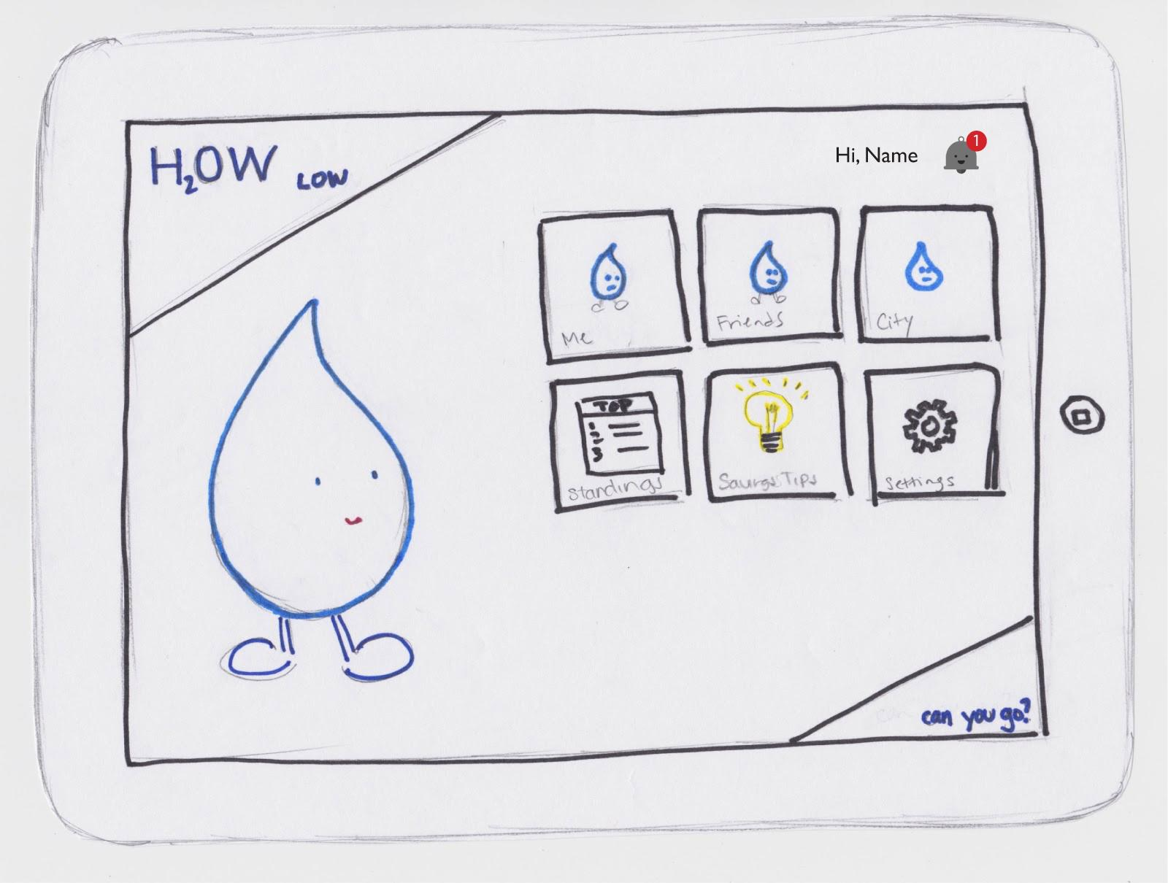
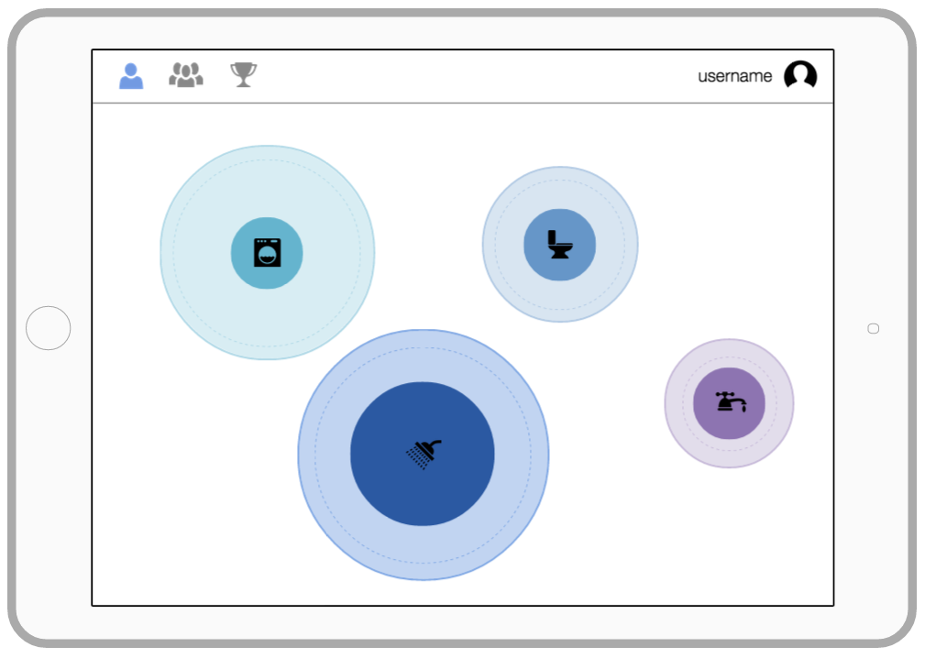
Revised UI design
Removed “home” screen -> cleaner navigation

Slide 5
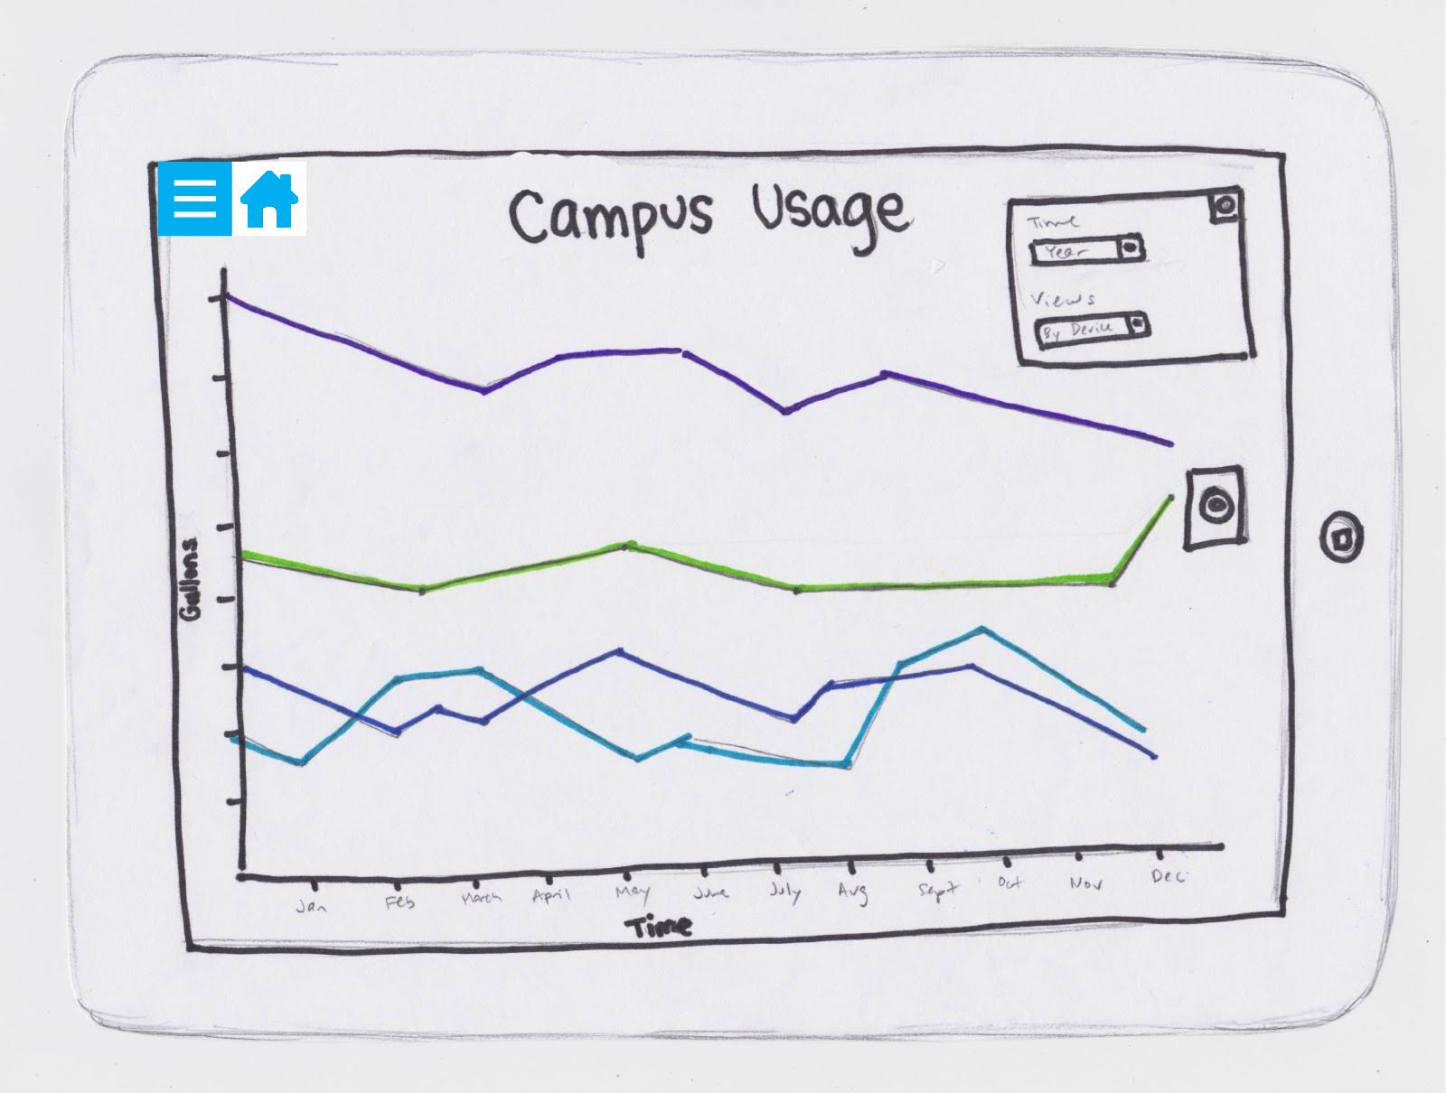
Revised UI design
Removed campus/city screen

Slide 6
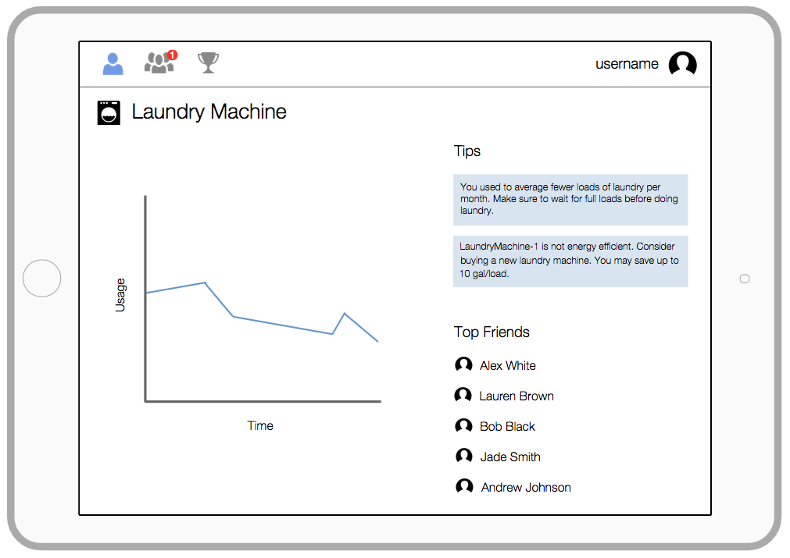
Revised UI design
Focused on individual usage

Slide 7
Revised UI design
Incorporated social/tips

Slide 8
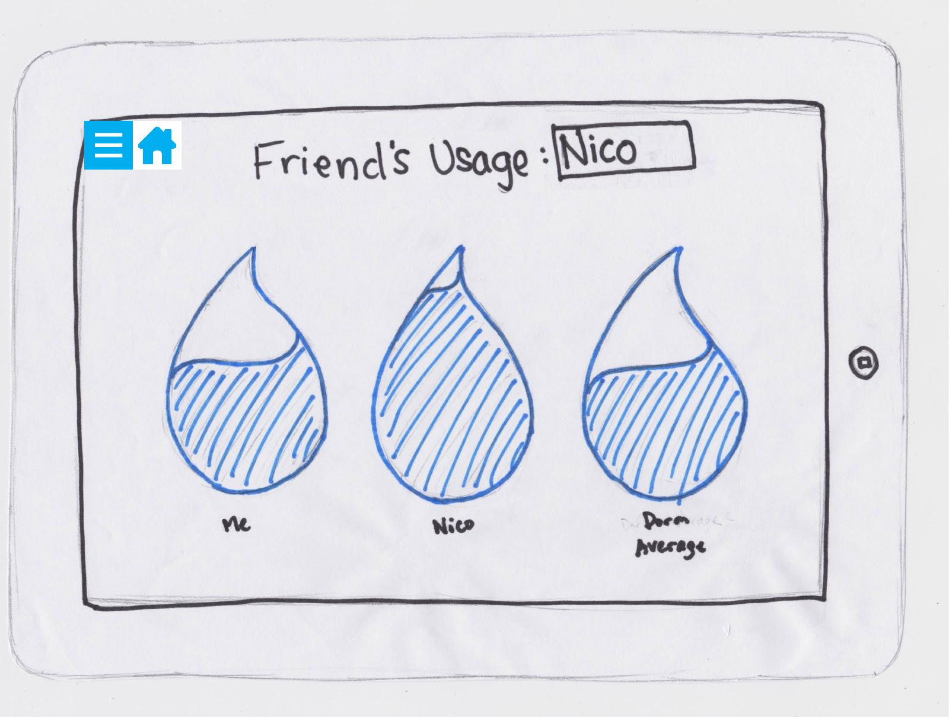
Revised UI design
Provided more data through visuals

Slide 9
Scenario 1:
Check personal water usage data

Slide 10
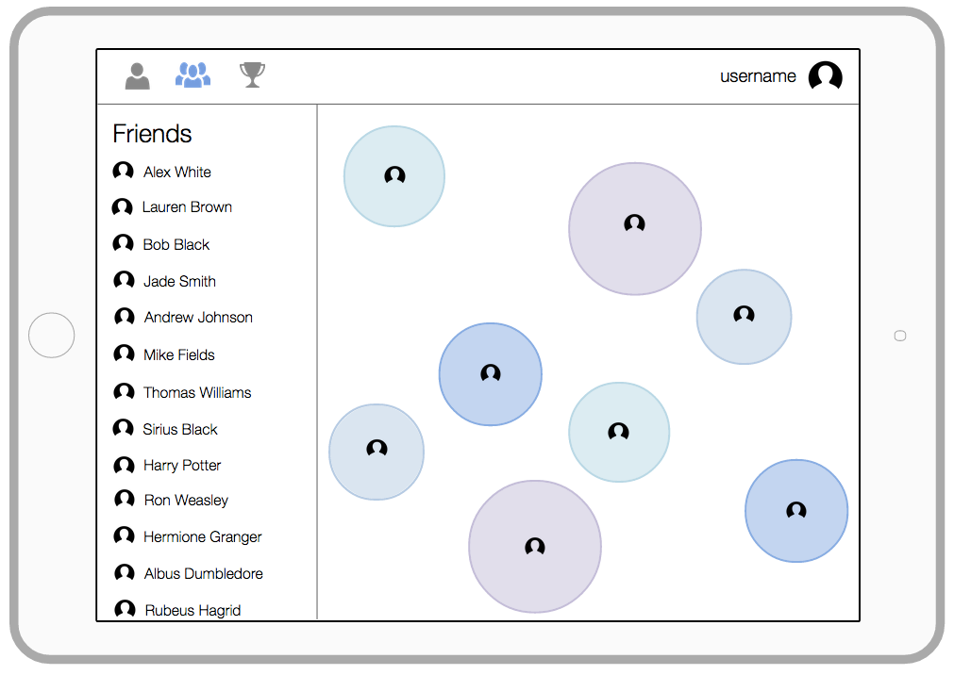
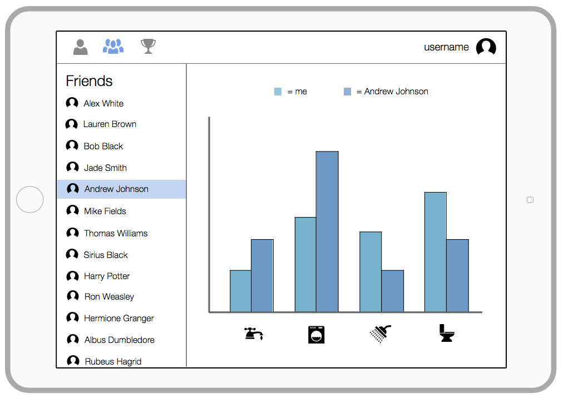
Scenario 2:
Compare water usage with friends

Slide 11
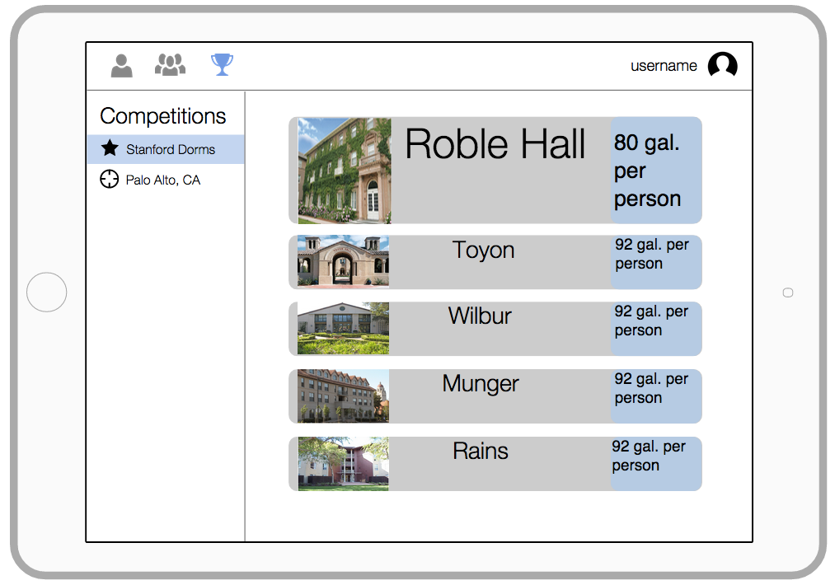
Scenario 3:
Find motivation to conserve

Slide 12
Tools Used
proto.io
interactive gestures
interactive elements (menus, lists)
collaborative editing difficult
Marvel and InVision
more static
bigger libraries of icons, etc. but not as interactive

Slide 13
Summary
Updated tasks to be more focused
Revised UI design to address tasks
Able to focus on flow between tasks

